Slide 1
Electrical Science-1 (15B11EC111)
Unit-1
Voltage Divider Rule
Lecture-6

Slide 2
Contents
Voltage Divider Rule
Voltage Divider Calculation for two series resistors
Voltage Divider Rule Using more than two Resistor
Example1
Example2
Practice Problem
References

Slide 3
Voltage Divider Rule
Definition
A voltage divider is a basic circuit, used to generate a part of its input voltage like an output. This circuit can be designed with two resistors otherwise any passive components along with a voltage source.
The resistors in the circuit can be connected in series whereas a voltage source is connected across these resistors. This circuit is also called a potential divider.
The input voltage can be transmitted between the two resistors in the circuit so that the division of voltage takes place.
Ref:1

Slide 4
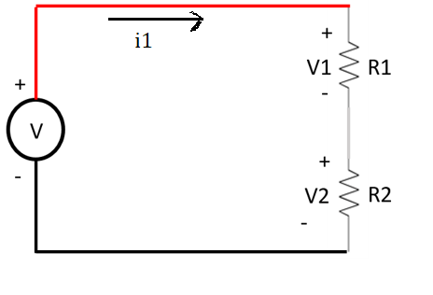
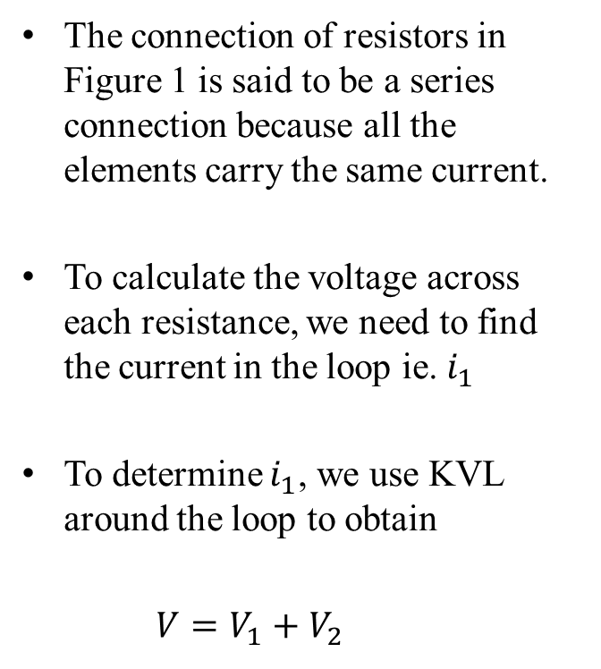
Voltage Divider Calculation for two series resistor
The connection of resistors in Figure 1 is said to be a series connection because all the elements carry the same current.
To calculate the voltage across each resistance, we need to find the current in the loop ie. $i_{1}$
To determine $i_{1}$, we use KVL around the loop to obtain
$V=V_{1}+V_{2}$
i1
Figure1
Ref:2

Slide 5

Contd..
Solving for $i_{1}$, we have
$i_{1}= \frac{V}{R_{1}+R_{2}}$ Eq3
Now, the voltage across resistor $R_{1}$ is
$V_{1}=R_{1}i_{1}=$ $\frac{R_{1}V}{R_{1}+R_{2}}$ Eq 4
Similarly
$V_{2}=R_{2}i_{1}=$ $\frac{R_{2}V}{R_{1}+R_{2}}$ Eq 4
Ref:2

Slide 6
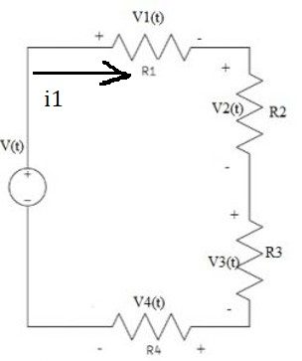
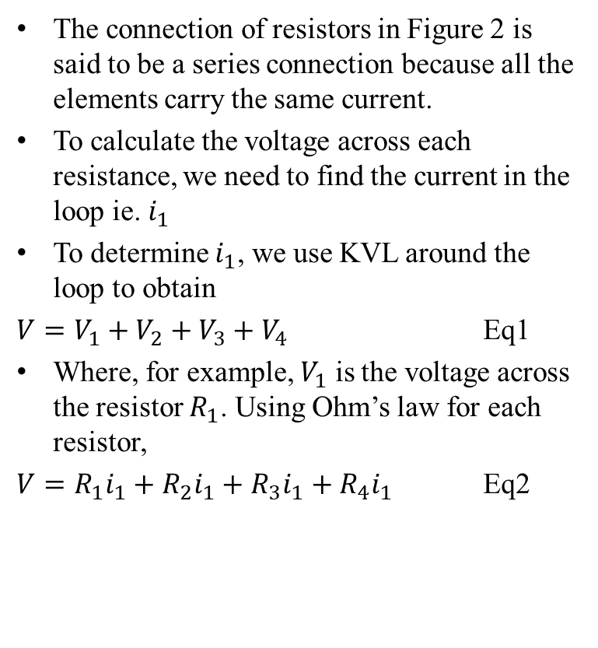
Voltage Divider Rule Using more than two Resistor
The connection of resistors in Figure 2 is said to be a series connection because all the elements carry the same current.
To calculate the voltage across each resistance, we need to find the current in the loop ie. $i_{1}$
To determine $i_{1}$, we use KVL around the loop to obtain
$V=V_{1}+V_{2}+V_{3}+V_{4}$ Eq1
Where, for example, $V_{1}$ is the voltage across the resistor $R_{1}$. Using Ohm’s law for each resistor,
$V=R_{1}i_{1}+R_{2}i_{1}+R_{3}i_{1}+R_{4}i_{1}$ Eq2
Figure 2
Ref:1

Slide 7
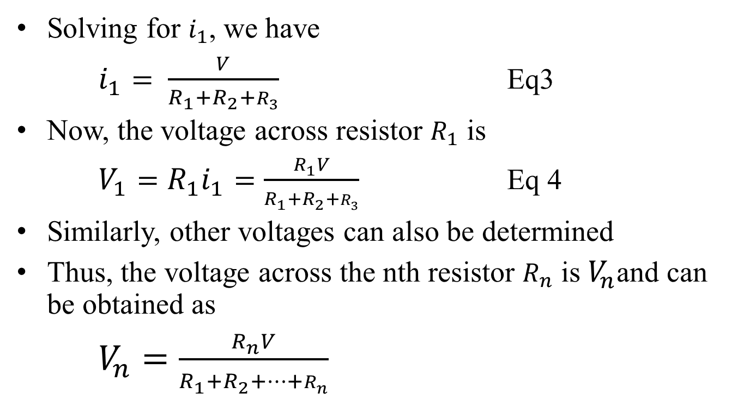
Contd..
Solving for $i_{1}$, we have
$i_{1}= \frac{V}{R_{1}+R_{2}+R_{3}}$ Eq3
Now, the voltage across resistor $R_{1}$ is
$V_{1}=R_{1}i_{1}=\frac{R_{1}V}{R_{1}+R_{2}+R_{3}}$ Eq 4
Similarly, other voltages can also be determined
Thus, the voltage across the nth resistor $R_{n}$ is${ V}_{n}$and can be obtained as
$V_{n}=\frac{R_{n}V}{R_{1}+R_{2}+…+R_{n}}$
Ref:1

Slide 8
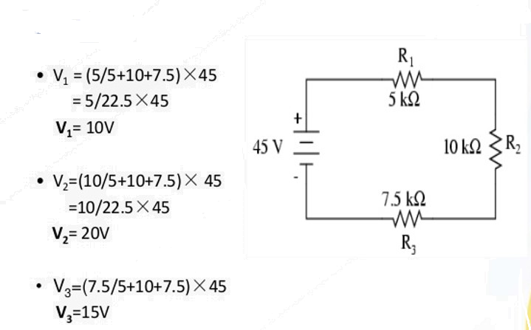
Example1
Ref:2

Slide 9
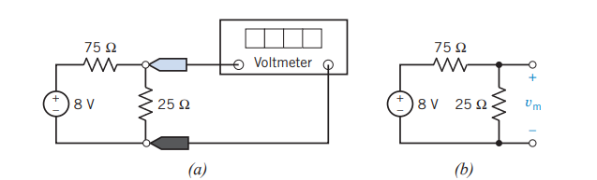

Practice Problem
Determine the voltage measured by the voltmeter in the circuit shown in Figure 3
Ans $Vm=2V$
Figure 3
Ref:1

Slide 10
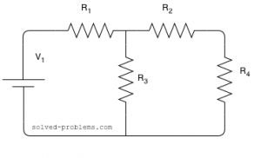
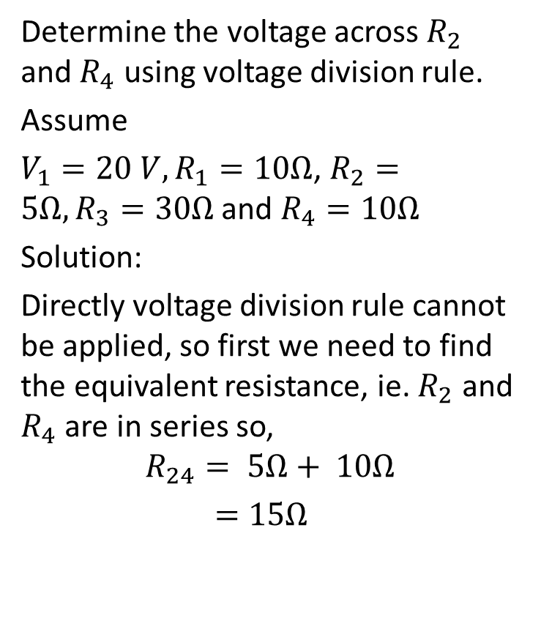
Example2
Determine the voltage across $R_{2}$ and $R_{4}$ using voltage division rule.
Assume
$V_{1}=20 V,R_{1}=10Ω$, $R_{2}=5Ω,R_{3}=30Ω$ and $R_{4}=10Ω$
Solution:
Directly voltage division rule cannot be applied, so first we need to find the equivalent resistance, ie. $R_{2}$ and $R_{4}$ are in series so,
$$R_{24}= 5Ω+ 10Ω$$
$=15Ω$
Figure 4
Ref:2

Slide 11
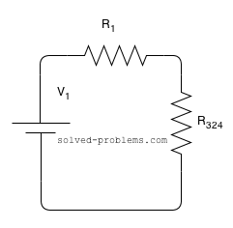
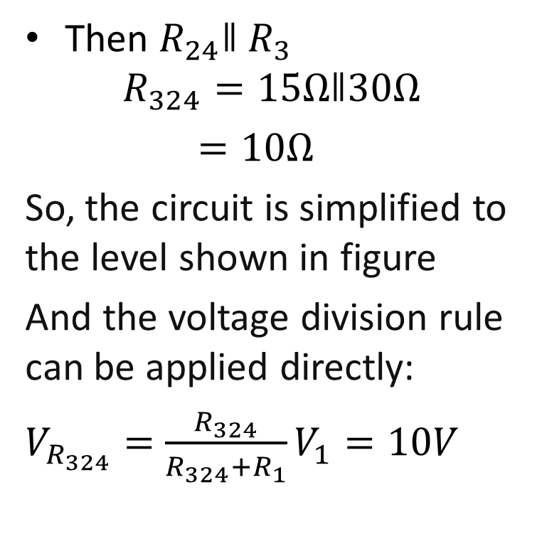
Contd..
Then $R_{24}ǁ$ $R_{3}$
$$R_{324}=15Ωǁ30Ω$$
$=10Ω$
So, the circuit is simplified to the level shown in figure
And the voltage division rule can be applied directly:
$V_{R_{324}}=$ $\frac{R_{324}}{R_{324}+R_{1}}V_{1}=10V$
Ref:2

Slide 12
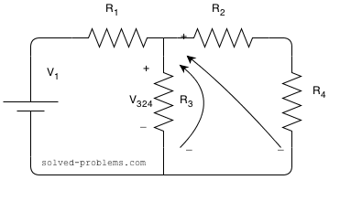
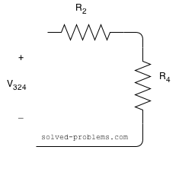
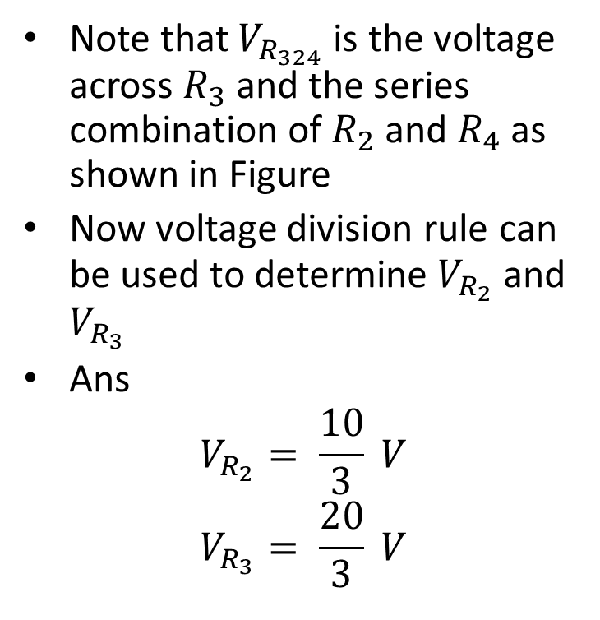
Contd..
Note that $V_{R_{324}}$ is the voltage across $R_{3}$ and the series combination of $R_{2}$ and $R_{4}$ as shown in Figure
Now voltage division rule can be used to determine $V_{R_{2}}$ and $V_{R_{3}}$
Ans
$$V_{R_{2}}= \frac{10}{3} V$$
$$V_{R_{3}}= \frac{20}{3} V$$
Ref:2

Slide 13
References
1. R.C. Dorf and James A. Svoboda, “Introduction to Electric Circuits”,9th ed, John Wiley & Sons, 2013.
2. D.C. Kulshreshtha, Basic Electrical Engineering, Revised 1st ed, Tata Mc Graw Hill, 2017

